Slide 1


Project: Travel Companion Website
Group Name - Fall2024_g10
Mayank Tiwari
Dattatreya Kantha
Omkar Mane
Swati More

Slide 2

Project Vision
The goal of our project is to create the quintessential travel companion designed to enable users to explore the world with both confidence and ease. Our platform aims to simplify trip planning by not only streamlining the process but also enhancing the overall travel experience with personalized local insights and advanced budget management features. We are committed to becoming the ultimate resource for travelers who desire tailor-made, engaging journeys that perfectly match their individual tastes and preferences.

Slide 3
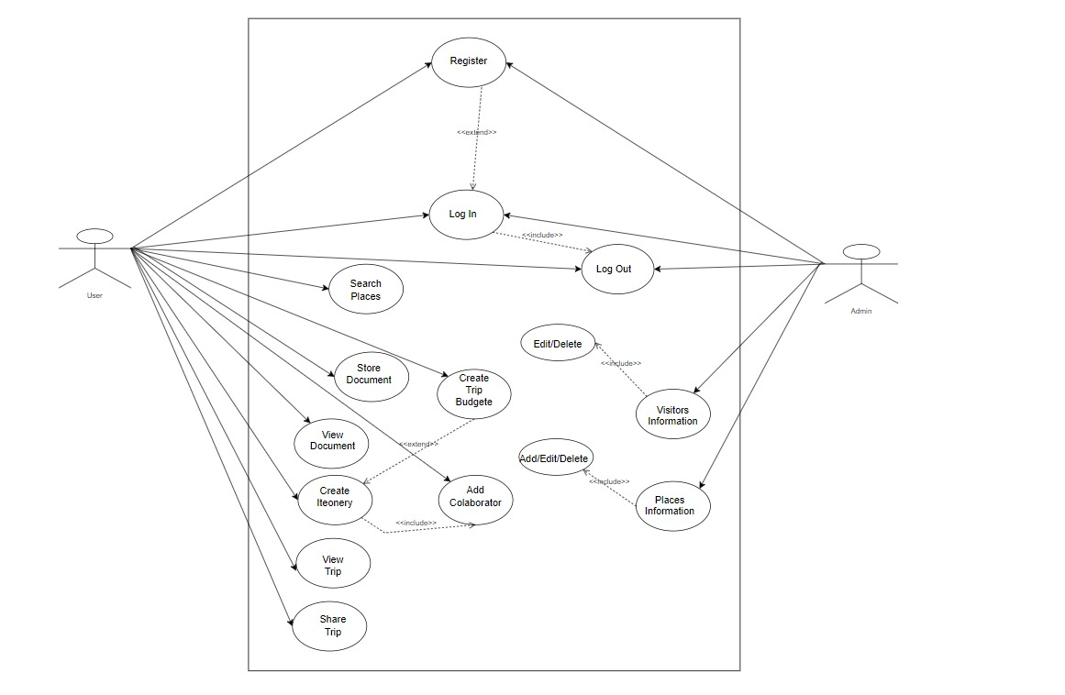
USE CASE DIAGRAM
Notes:
Make sure your review your model and remove types, e.g., “Iteonery”, ”Budgete”
Try to use verbs to make the model more clear, for instance, I do not know what you mean by “Places Information”
Finally, add a description of each use so we can understand what they do

Slide 4
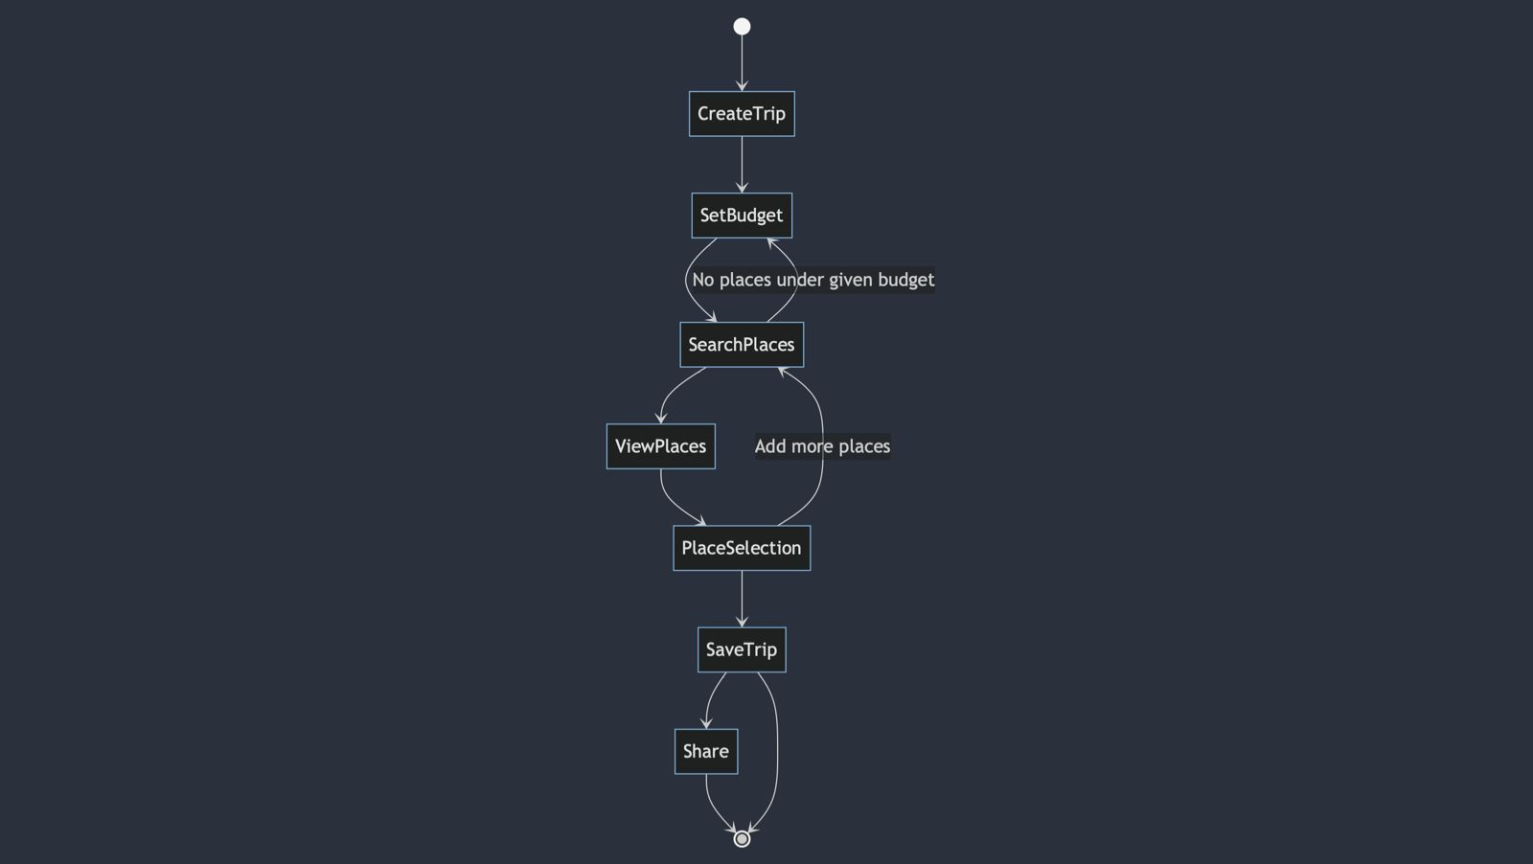
STATE DIAGRAM
Notes:
What class are you referring to? This is not a state diagram. It looks like to be an activity diagram.

Slide 5
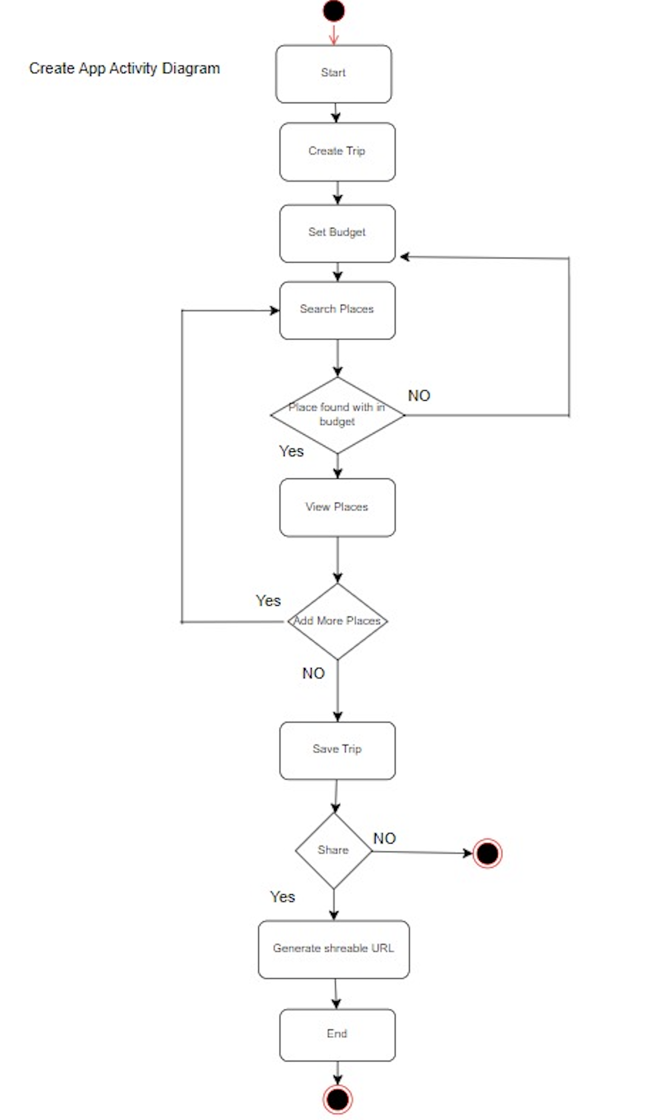
ACTIVITY DIGRAM
Notes:
There is not traceability between this activity diagram and the use case model.
You do not need an activity “start”, since the start node implies it is a start. The same regarding the action “end”

Slide 6
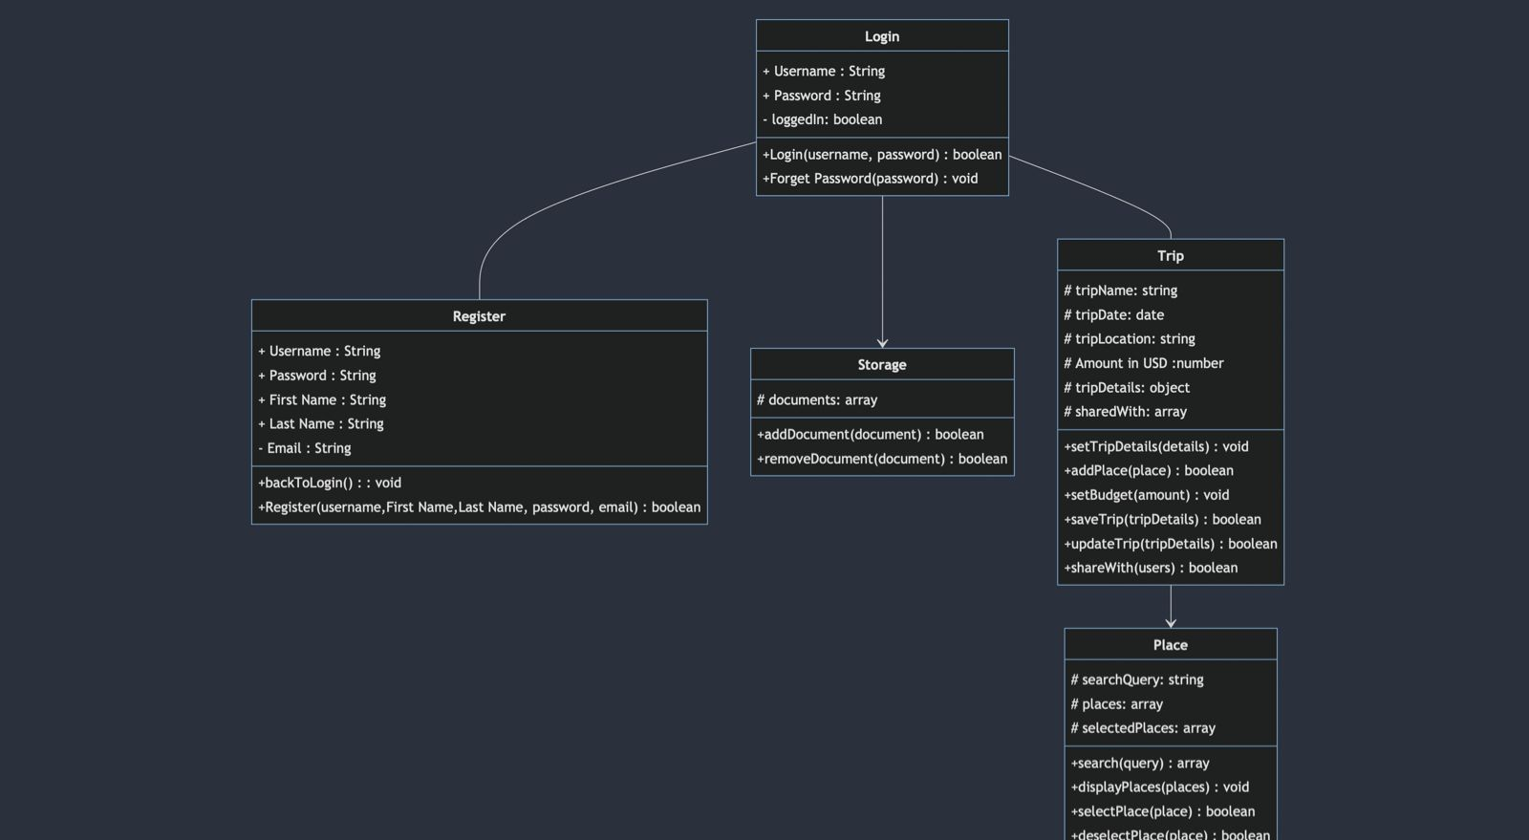
CLASS DIAGRAM
Notes:
It is not clear what is the meaning the relationship among the cited classes. What is the cardinality?

Slide 7
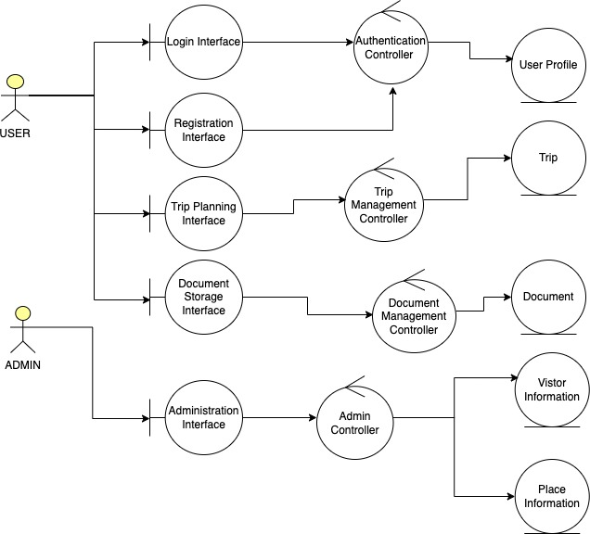
ROBUSTNESS ANALYSIS
Notes:
No traceability between this diagram and the class diagram. In addition, it is difficult to understand what “use cases” (features) this diagram is related to.

Slide 8
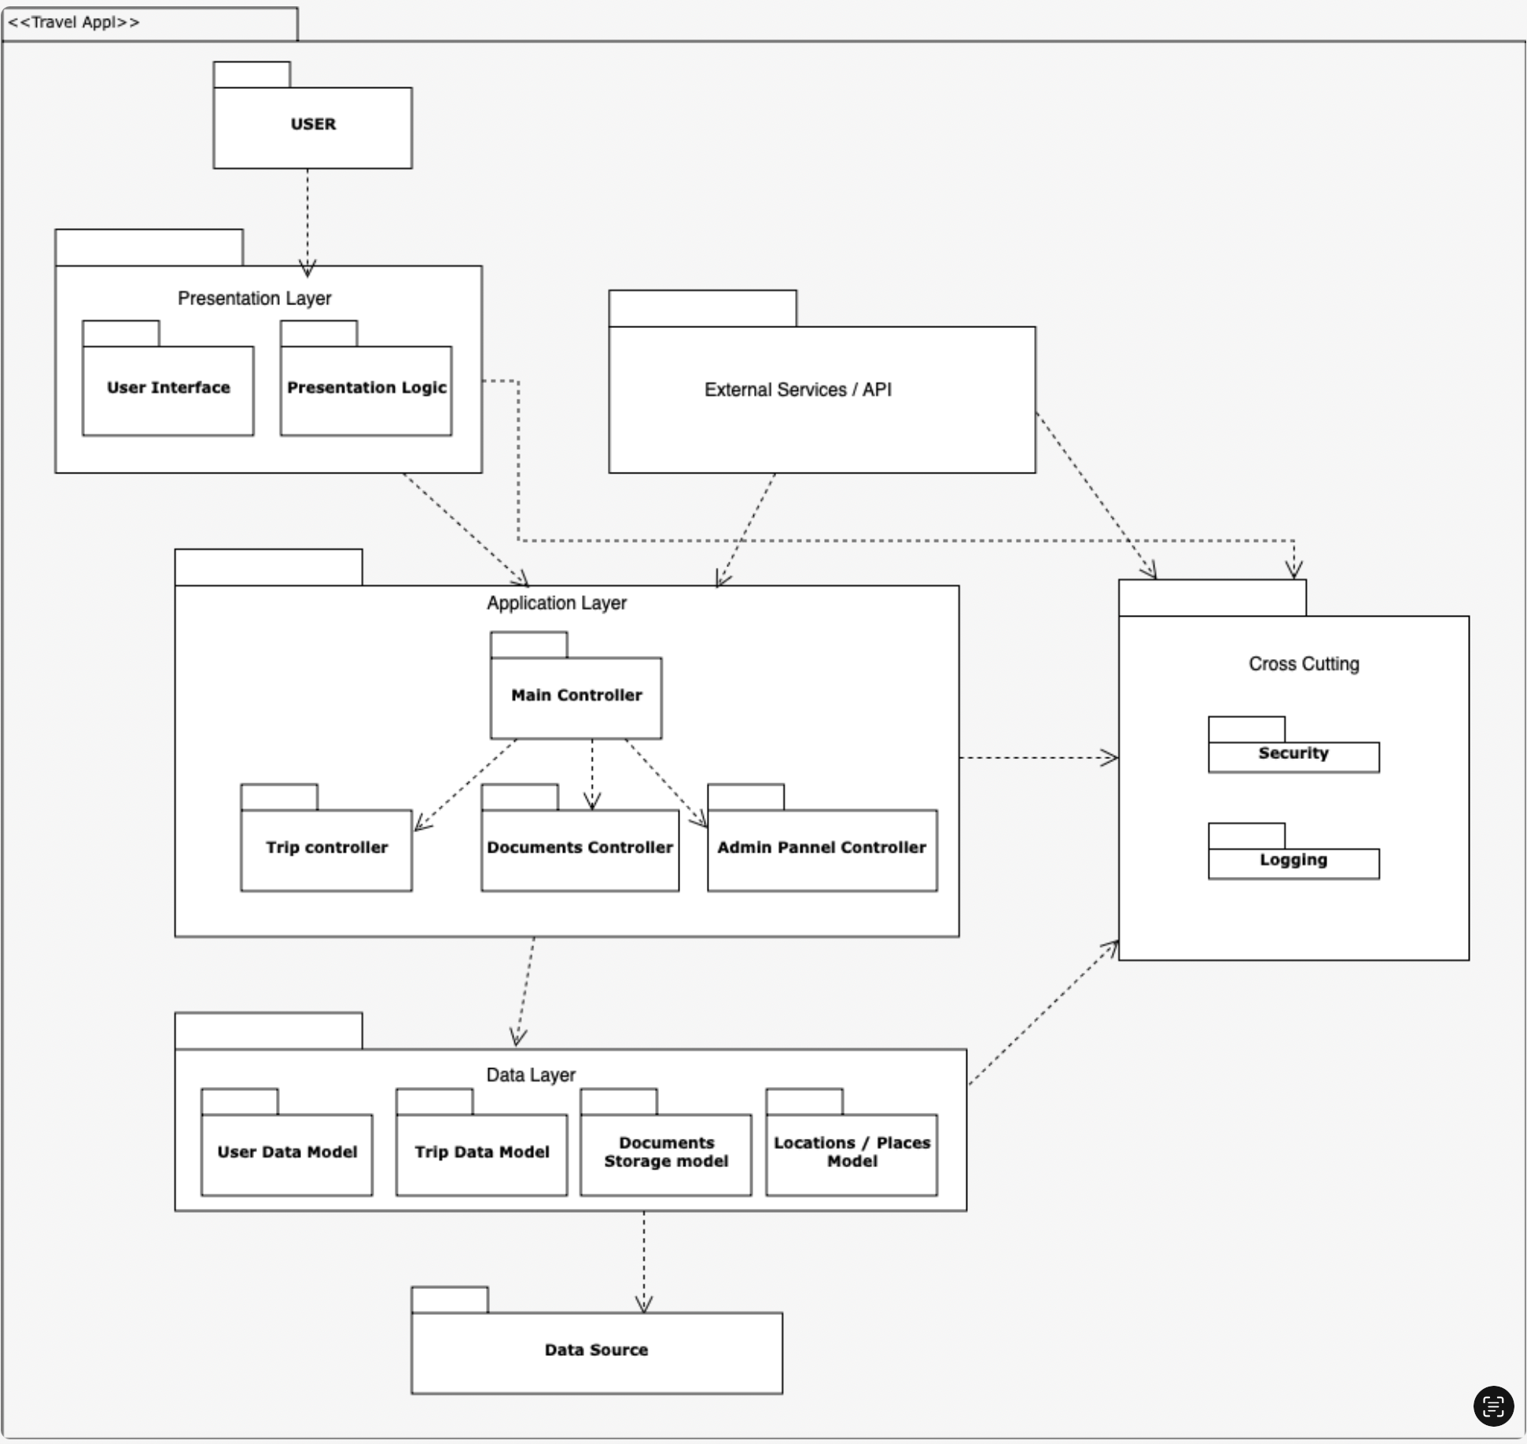
PACKAGE DIAGRAM

Slide 9

Notes:
Make sure all the diagrams are consistent and can be mapped to each other. Traceability is very important. An OO project is not a set of pictures, but models that are related to each other.

Slide 10
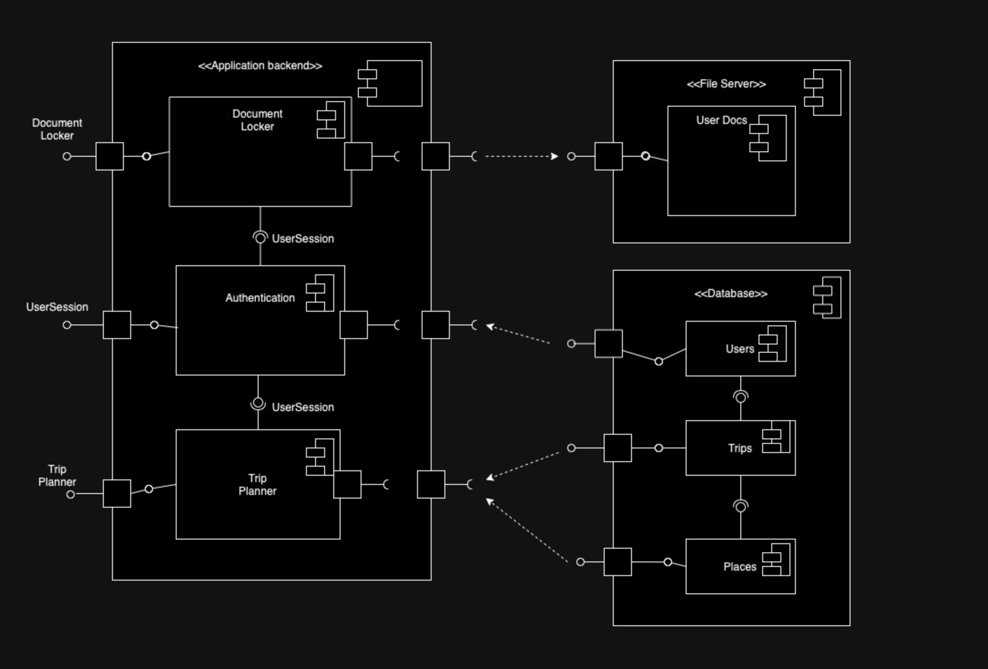
COMPONENT DIAGRAM

Slide 11
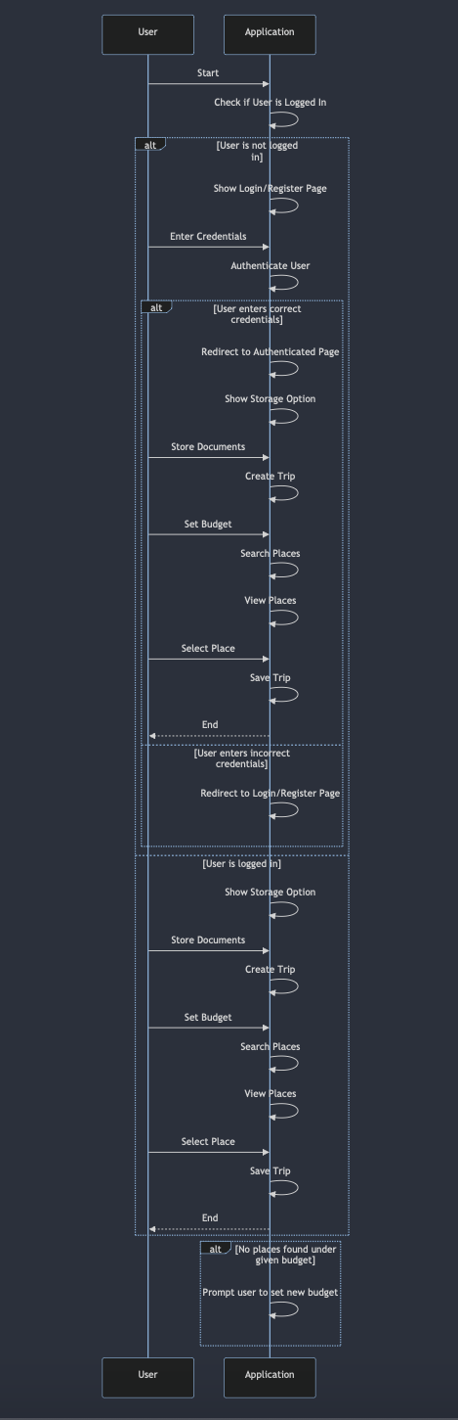
SEQUENCE DIAGRAM

Slide 12
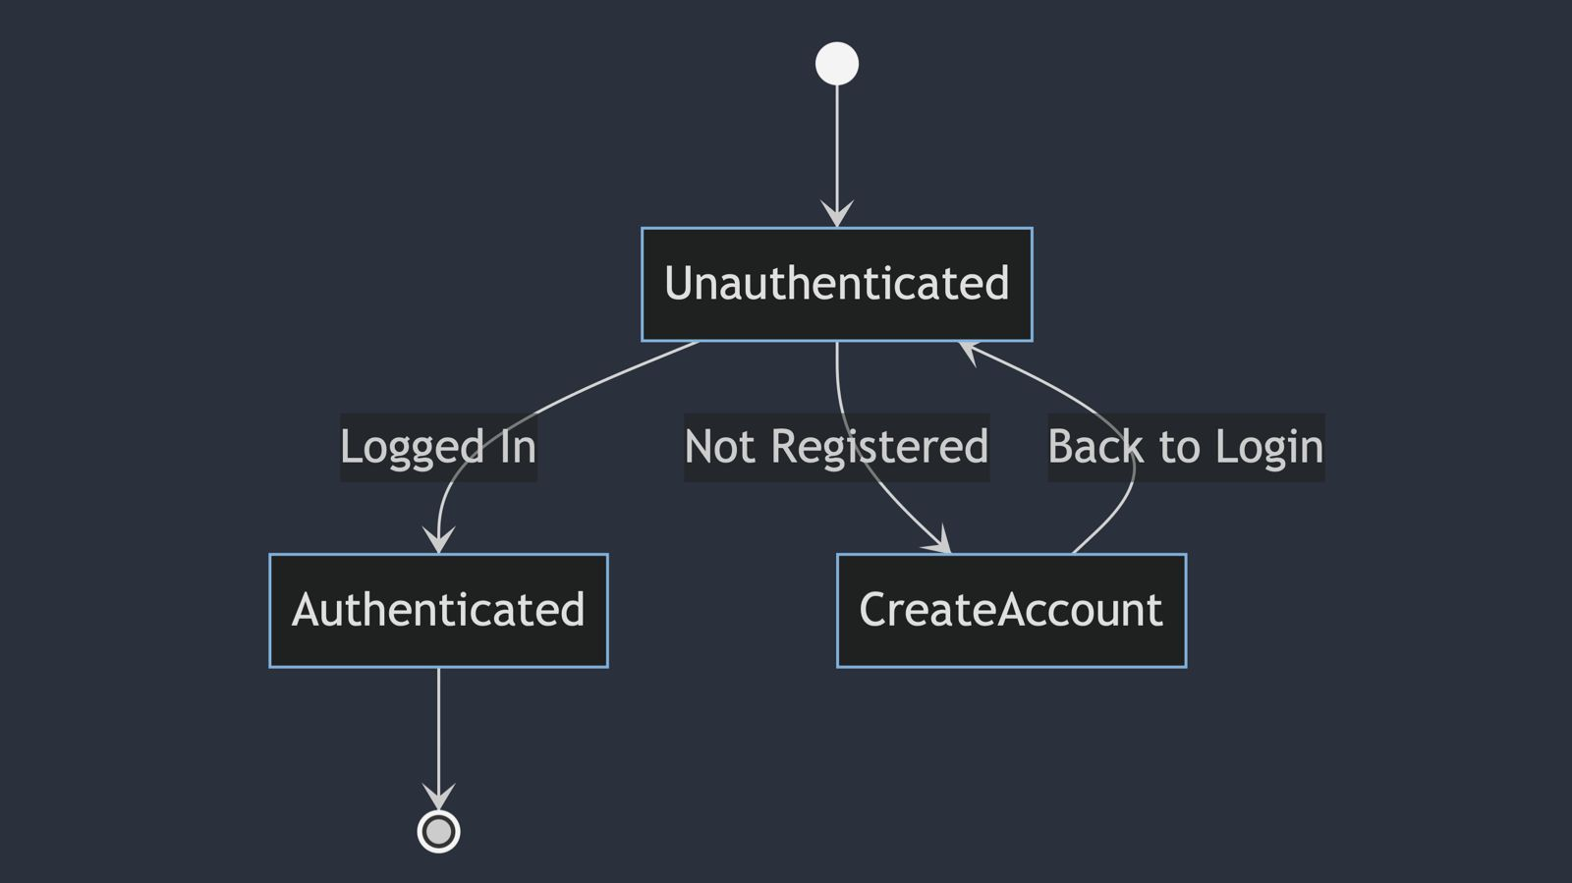
LOGIN STATE DIAGRAM

Slide 13
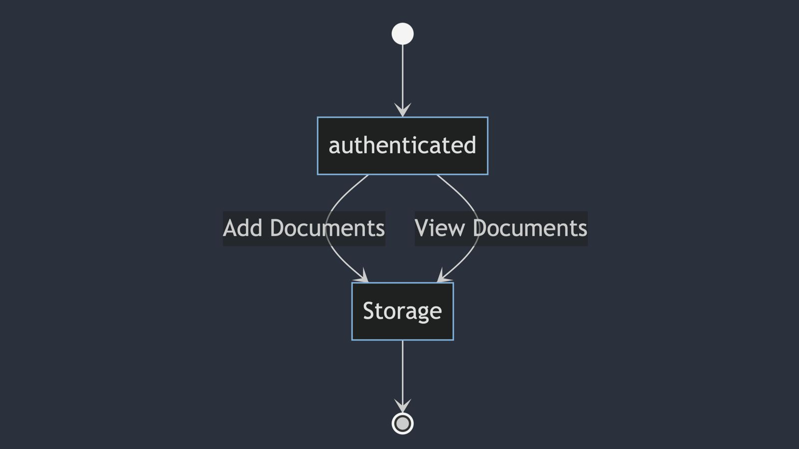
STORAGE STATE DIAGRAM

Slide 14
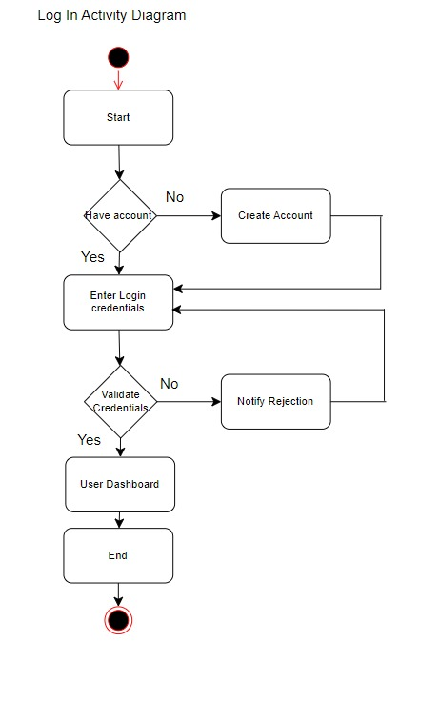
LOGIN ACTIVITY DIAGRAM

Slide 15
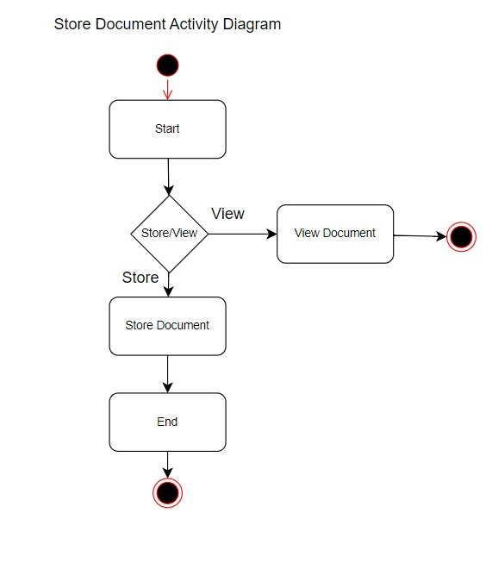
STORAGE ACTIVITY DIAGRAM

